Slide 1
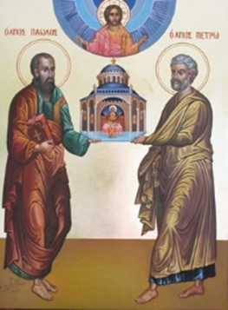
The History of the Biblical Church
A Five-Week Teaching Series
Beginning Wednesday Night, September 14th
Eucharistic Service from 7:00 – 8:30
Free Soup Supper from 6:00 – 6:45
Childcare Provided throughout Service
For More Information Visit:
www.MyCOMJax.com
#BiblicalChurch

Slide 2
The Prison Epistles

Slide 3
St. Paul’s Epistles to the Churches of the Ephesians, Philippians, and Colossians as well as his Epistle to Philemon are collectively referred to as “The Prison Epistles.”

Slide 4
These letters are called this because in each of them St. Paul refers to being imprisoned or in chains. This is not metaphorical; St. Paul was held captive during the time these letters were written.
Ephesians 3:1; 4:1; 6:20.
Philippians 1:7, 13.
Colossians 4:10, 18.
Philemon 1, 9, 10.

Slide 5
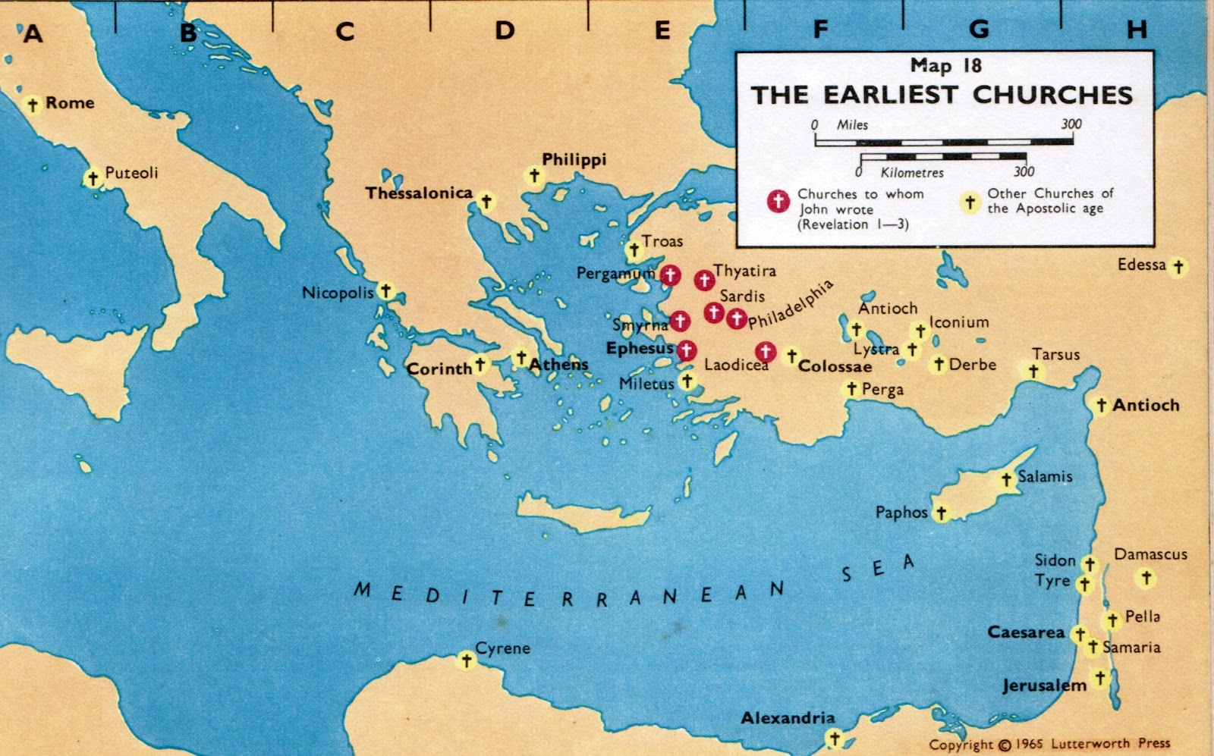

Slide 6
Epistles to the Philippians
St. Paul writes the epistle along with Timothy
Paul hopes to send Timothy along with Epaphroditus, who had been very ill, to Philippi shortly
Paul entreats Euodia and Syntyche to resolve their disagreement, since they were so helpful along with Clement.

Slide 7
The Epistle to the Colossians
St. Paul never visited Colossae (2:1)
St. Paul writes the letter with Timothy
St. Paul sent the letter via Tychicus and Onesimus. (4:7-9)
He wants this letter read in Laodicea and their letter read in Colossae!
He has very specific instructions for Archippus (4:17)

Slide 8
The Epistle to Philemon
Only Prison Epistle written to a person
Co-authored by St. Paul and Timothy
Written to address a specific situation
Written “To Philemon our beloved fellow worker and Apphia our sister and Archippus our fellow soldier, and the church in your house”
Mentions all the same people at the end of the this letter and Colossians.

Slide 9
The Epistle to the Ephesians
Not co-authored with St. Timothy!
Very non-specific feel to it.
Only mentions one person by name: Tychicus
Most likely intended to be an encyclical letter.

Slide 10
Who is this Tychicus person?
He was an Asian who was with Paul on the 3rd Missionary Journey (Acts 20:4)
He carried the Letter to the Colossians (Colossians 4:7)
Very late in his life, Paul sent him to Ephesus (2 Timothy 4:12)
Either he or Artemas would have carried the Epistle to Titus. (Titus 3:12)

Slide 11
What about When & Where?
Philippians 1:13 refers to the “Imperial palace” which in Greek is the Praetorio. Because of this most assume that these Epistles were all written from Rome, but there were actually Praetorian households in Rome, Ephesus, and Caesarea!

Slide 12
What we know about the Epistles…
Paul was in prison
He might die among the Praetorian Guards, though he hoped to be released
Timothy was with him (?)
He had communications with the cities beyond just the epistles.

Slide 13
Were they written from Caesarea?
St. Paul was held in prison there for two years. (Acts 23:33—26:32)
There is no evidence that Timothy went back to Jerusalem with St. Paul.
Philippi was roughly 1,000 miles by land or sea from Caesarea so back-and-forth communication would be very difficult.

Slide 14
Were they written from Rome?
St. Paul was held prisoner for at least two years in Rome (Acts 28:30)
Again, there is no evidence that Timothy was in Rome with Paul.
Again from Philippi to Rome would be roughly 900 miles making communication very challenging.

Slide 15
Were they written from Ephesus?
While St. Paul was in Ephesus for three years, there is no record of him being in prison exactly…
In the Corinthian Correspondence St. Paul mentions fighting “wild beasts” and a death sentence. (I Cor 15:32; II Cor 1:8-10)
St. Paul also writes of “more imprisonments” (II Cor 6:5; 11:23)

Slide 16
Were they written from Ephesus?
The journey from Ephesus to Philippi is less than 400 miles
The journey from Ephesus to Colossae is roughly 175 miles.
Either journey would have taken less than a week.

Slide 17
Were they written from Ephesus?
Timothy was with Paul in Ephesus but
Why write an Epistle to the city you are in?
Timothy is not a co-author of Ephesians.

Slide 18
Possible Conclusion:
At some point during his three-year stay in Ephesus, St. Paul (along with Timothy) was imprisoned and wrote his Epistles to the Philippians, to the Colossians, and to Philemon.
This would make the date of these Prison Epistles roughly 56 AD.

Slide 19
Possible Conclusion:
At a later date, during St. Paul’s imprisonment in Rome, the Apostle sent Tychicus to Ephesus (2 Timothy 4:12) with the Epistle to the Ephesians.
This could explain why Timothy is not a co-author and there are no familiar references to the happenings in Ephesus in the letter.

Slide 20
Possible Conclusion:
This would make the Epistle to the Ephesians written from Rome between 61-63 AD during St. Paul’s arrest there.

Slide 21
Interesting to note:
Timothy is traditionally venerated as the first bishop of Ephesus.
In his Epistle to the Ephesians, Ignatius of Antioch (d. 107 AD), wrote of “Onesimus… your bishop.”
The entire city of Colossae was cataclysmically destroyed by an earthquake in 60 AD.

