Slide 1
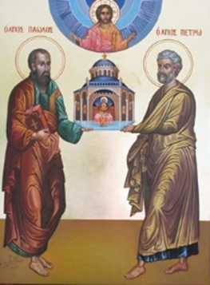
The History of the Biblical Church
A Five-Week Teaching Series
Beginning Wednesday Night, September 14th
Eucharistic Service from 7:00 – 8:30
Free Soup Supper from 6:00 – 6:45
Childcare Provided throughout Service
For More Information Visit:
www.MyCOMJax.com
#BiblicalChurch

Slide 2
Thessalonica

Slide 3
Thessalonica
The city still stands today although it is known as Thessaloniki.

Slide 4
Thessalonica
The city still stands today although it is known as Thessaloniki.
In St. Paul’s day it was one of four capitols of the Roman province of Macedonia.

Slide 5
Thessalonica
The city still stands today although it is known as Thessaloniki.
In St. Paul’s day it was one of four capitols of the Roman province of Macedonia.
It was a key city on the vitally important Via Egnatia.

Slide 6
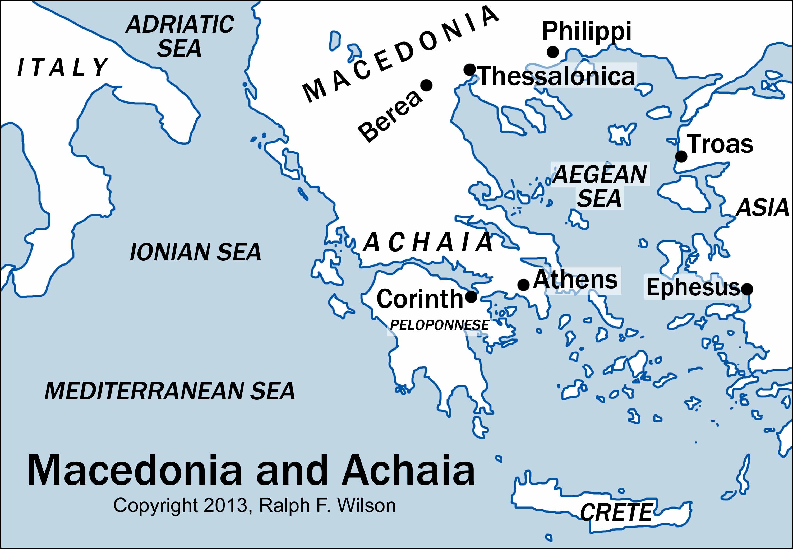
Thessalonica

Slide 7
On the 2nd Missionary Journey—after passing through Lystra and Derbe and picking up Timothy—Paul, Silas, and Luke cross over the Aegean Sea. On their way to Europe, they quickly pass through Samothrace and Neapolis before arriving at Philippi. Chapter 16 of Acts of the Apostles details the Macedonian call and ministry in Philippi.

Slide 8
After the incident with the Philippian Jailer, St. Paul and company leave and head to Thessalonica. They remain there for at least “three Sabbaths” so that “some of them were persuaded; and a great multitude of the devout Greeks, and not a few of the leading women, joined Paul and Silas.”
Acts of the Apostles 17:2,4

Slide 9
Thessalonica

Slide 10
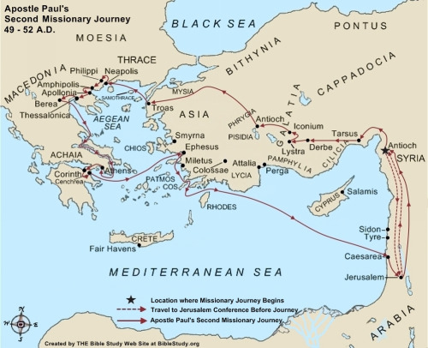
St. Paul’s Second Journey

Slide 11
We also see Thessalonica mentioned 6 more times:
Twice in reference to Aristarchus (Acts of the Apostles 20:4; 27:2)
A reference to the Philippians’ generosity while Paul was in Thessalonica (Philippians 4:16)
“To the Church of the Thessalonians”
When Demas leaves for the city (2 Timothy 4:10)

Slide 12
So when and from where did St. Paul write
I and II Thessalonians?

Slide 13
A big key to answering these questions is found in one of the most over-looked verses in the entire letter.
“Paul, Silvanus, and Timothy,
To the church of the Thessalonians in God the Father and the Lord Jesus Christ:
Grace to you and peace from God our Father and the Lord Jesus Christ.”
I Thessalonians 1:1 and II Thessalonians 1:1

Slide 14
When were Paul, Silvanus, and Timothy together after Paul’s visit to Thessalonica?

Slide 15
When were Paul, Silvanus, and Timothy together after Paul’s visit to Thessalonica?
Silvanus and Silas are the same person!

Slide 16
When were Paul, Silvanus, and Timothy together after Paul’s visit to Thessalonica?
Silvanus and Silas are the same person!
Paul left Silas & Timothy at Berea (17:14)

Slide 17
When were Paul, Silvanus, and Timothy together after Paul’s visit to Thessalonica?
Silvanus and Silas are the same person!
Paul left Silas & Timothy at Berea (17:14)
Silas & Timothy rejoin Paul in Corinth (18:5)

Slide 18
When were Paul, Silvanus, and Timothy together after Paul’s visit to Thessalonica?
Silvanus and Silas are the same person!
Paul left Silas & Timothy at Berea (17:14)
Silas & Timothy rejoin Paul in Corinth (18:5)
When he leaves Corinth, Paul takes Aquila & Priscilla with him, not Silas & Timothy. (18:18)

Slide 19
When were Paul, Silvanus, and Timothy together after Paul’s visit to Thessalonica?
Silas is never mentioned again after Corinth but Silvanus is. (2 Corinthian 2:19; 2 Peter 5:12)

Slide 20
When were Paul, Silvanus, and Timothy together after Paul’s visit to Thessalonica?
Silas is never mentioned again after Corinth but Silvanus is. (2 Corinthian 2:19; 2 Peter 5:12)
Tradition says Silas became the first bishop of Corinth

Slide 21
When were Paul, Silvanus, and Timothy together after Paul’s visit to Thessalonica?
Silas is never mentioned again after Corinth but Silvanus is. (2 Corinthian 2:19; 2 Peter 5:12)
Tradition says Silas became the first bishop of Corinth
On the 3rd Missionary Journey Paul sends Timothy into Macedonia but not into Achaia (Acts 19:22; 20:4)

Slide 22
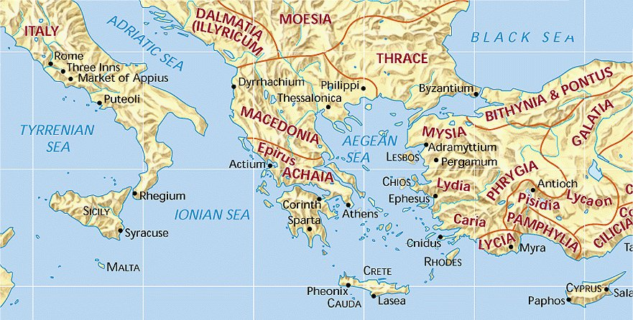

Slide 23
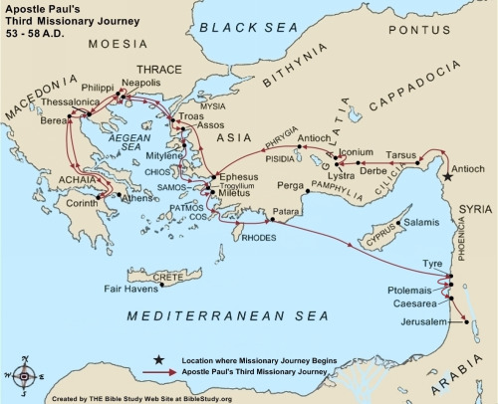
St. Paul’s Third Journey

Slide 24
Conclusion:
The most likely time St. Paul could have written both letters to the Thessalonians was during his 18 month stay in Corinth during the 2nd Missionary Journey.
This means I & II Thessalonians may very well be the oldest of the Pauline writings in the Bible.

