Slide 1
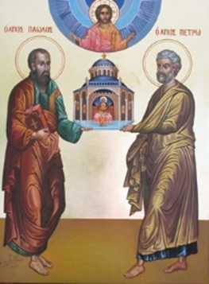
The History of the Biblical Church
A Five-Week Teaching Series
Beginning Wednesday Night, September 14th
Eucharistic Service from 7:00 – 8:30
Free Soup Supper from 6:00 – 6:45
Childcare Provided throughout Service
For More Information Visit:
www.MyCOMJax.com
#BiblicalChurch

Slide 2
“Inasmuch as many have taken in hand to set in order a narrative of those things which have been fulfilled among us, just as those who from the beginning were eyewitnesses and ministers of the word delivered them to us, it seemed good to me also, having had perfect understanding of all things from the very first, to write to you an orderly account, most excellent Theophilus, that you may know the certainty of those things in which you were instructed.”
St. Luke 1:1-4

Slide 3
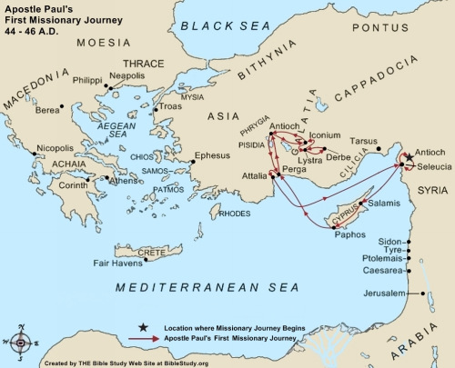
St. Paul’s First Journey

Slide 4
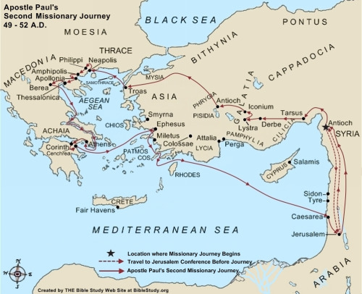
St. Paul’s Second Journey

Slide 5
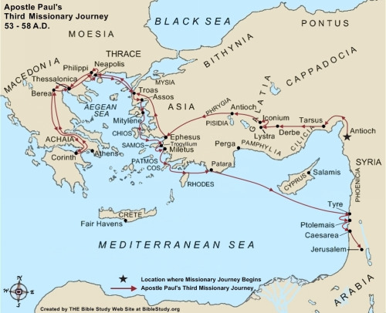
St. Paul’s Third Journey

Slide 6
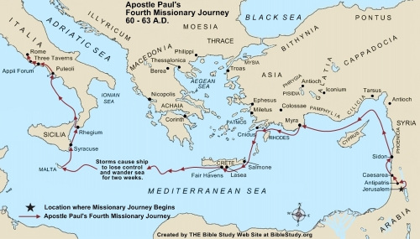
St. Paul’s Fourth Journey

Slide 7
So what’s wrong with Acts?

Slide 8
So what’s wrong with Acts?
Nothing

Slide 9
So what’s wrong with Acts?
Nothing
“All Scripture is given by inspiration of God, and is profitable for doctrine, for reproof, for correction, for instruction in righteousness, that the man of God may be complete, thoroughly equipped for every good work.”
I Timothy 3:16-17

Slide 10
So what’s wrong with Acts?
Nothing… but

Slide 11
So what’s wrong with Acts?
Nothing… but
It’s only one person’s point of view

Slide 12
So what’s wrong with Acts?
Nothing… but
It’s only one person’s point of view
It never mentions St. Paul writing any of his epistles

Slide 13
So what’s wrong with Acts?
Nothing… but
It’s only one person’s point of view,
It never mentions St. Paul writing any of his epistles,
It leaves out some important details.

Slide 14
What did St. Luke leave out of Acts?

Slide 15
What did St. Luke leave out of Acts?
Where was St. Luke on these trips?

Slide 16
There are several passages in Acts where St. Luke uses the word “we”. Those are:
Acts 16:10–17; 20:5–15; 21:1–18; 27:1–28; 28:1-16

Slide 17
There are several passages in Acts where St. Luke uses the word “we”. Those are:
Acts 16:10–17; 20:5–15; 21:1–18; 27:1–28; 28:1-16
St. Luke also includes lengthy speeches from St. Paul on a few occasions where he has not admitted he was there.

Slide 18
What did St. Luke leave out of Acts?
Where was St. Luke on these trips?
What happened on the Third Missionary Journey where they were not in Ephesus?

Slide 19
Chapters 19-20 recount the Third Missionary Journey, but all of Chapter 19 happens in Ephesus over the course of two years. When St. Paul leaves Ephesus he travels Greece and Macedonia during a roughly four month time period that is covered in five verses. St. Paul then heads back to the area around Ephesus before leaving for Jerusalem.

Slide 20
St. Paul’s Third Journey

Slide 21
Acts 20 never specifically says that St. Paul traveled to Corinth on the Third Missionary Journey, so why is it on the map?

Slide 22
Acts 20 never specifically says that St. Paul traveled to Corinth on the Third Missionary Journey, so why is it on the map?
St. Paul said, “Now I will come to you when I pass through Macedonia,” in I Corinthians 16:5 and in II Corinthians 2:1, “For I made up my mind not to make another painful visit to you.”

