Slide 1
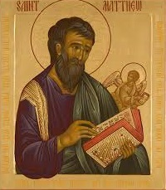
Church of the Messiah
invites you to
Follow Me:
an Introduction to the Gospel
According to Saint Matthew
An 8-Week Study of the Gospel
beginning July 16th at 7pm
3754 University Club Blvd.
mycomjax.com
#FollowMe

Slide 2
Follow Me: The Gospel According to St. Matthew
Week 1—July 16th: Introduction
Week 2—July 23rd: The Infancy Narrative
Week 3—July 30th: The Beginning of Jesus’ Ministry and the Sermon on the Mount
August 6th—Feast of the Transfiguration
Week 4—August 13th: Jesus’s Miracles and the Missionary Discourse

Slide 3
Follow Me: The Gospel According to St. Matthew
Week 5—August 20th: Jesus Rejected & Parables of the Kingdom
Week 6—August 27th: Miracles, Controversies, and the Cross, & Advice to the Church
Week 7—September 3rd: The Olivet Discourse
Week 8—September 10th: Jesus’ Passion and Resurrection

Slide 4
Follow Me: The Gospel According to St. Matthew
A Bible Study in Two Parts

Slide 5
Follow Me: The Gospel According to St. Matthew
A Bible Study in Two Parts
The Beginning of Jesus’ Ministry (3-4)

Slide 6
Follow Me: The Gospel According to St. Matthew
A Bible Study in Two Parts
The Beginning of Jesus’ Ministry (3-4)
The Sermon on the Mount (5-7)

Slide 7
Follow Me: The Gospel According to St. Matthew
The Beginning of Jesus’ Ministry
Key Verse:
“Repent, for the kingdom of heaven is at hand.”

Slide 8
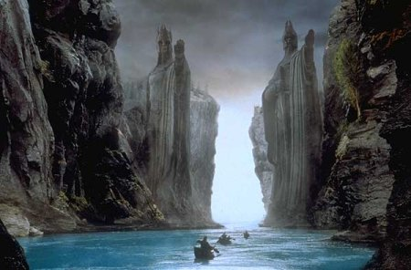
Follow Me: The Gospel According to St. Matthew

Slide 9
Follow Me: The Gospel According to St. Matthew

Slide 10
Follow Me: The Gospel According to St. Matthew
“Repent, for the kingdom of heaven is at hand.”
This verse is repeated, word for word, first by John the Baptist and then by Jesus in verses 3:2 and again in 4:17. In Biblical Studies this is called “Bookending” and it performs all the same functions that placing fancy bookends on your shelves does at home.

Slide 11
Follow Me: The Gospel According to St. Matthew
What’s not included between the bookends?

Slide 12
Follow Me: The Gospel According to St. Matthew
What’s not included between the bookends? On the front end, it’s all about setting.

Slide 13
Follow Me: The Gospel According to St. Matthew
What’s not included between the bookends? On the front end, it’s all about setting.
“In those days John the Baptist came preaching in the wilderness of Judea, and saying,…”

Slide 14
Follow Me: The Gospel According to St. Matthew
On the back end, it prepares a different setting and establishes the protagonist as the real hero.

Slide 15
Follow Me: The Gospel According to St. Matthew
On the back end, it prepares a different setting and establishes the protagonist as the real hero.
“And Jesus went about all Galilee, teaching in their synagogues, preaching the gospel of the kingdom, and healing all kinds of sickness and all kinds of disease among the people. Then His fame went throughout all Syria… Great multitudes followed Him—from Galilee, and from Decapolis, Jerusalem, Judea, and beyond the Jordan.”

Slide 16
Follow Me: The Gospel According to St. Matthew
So what is between the Bookends?

Slide 17
Follow Me: The Gospel According to St. Matthew
So what is between the Bookends?
John the Baptist’s preaching & ministry

Slide 18
Follow Me: The Gospel According to St. Matthew
So what is between the Bookends?
John the Baptist’s preaching & ministry
Jesus’ Baptism

Slide 19
Follow Me: The Gospel According to St. Matthew
So what is between the Bookends?
John the Baptist’s preaching & ministry
Jesus’ Baptism
Jesus overcomes Satan’s Temptations

Slide 20
Follow Me: The Gospel According to St. Matthew
So what is between the Bookends?
John the Baptist’s preaching & ministry
Jesus’ Baptism
Jesus overcomes Satan’s Temptations
“From that time Jesus began to preach and say…”

Slide 21
Follow Me: The Gospel According to St. Matthew
John the Baptist’s Preaching and Ministry

Slide 22
Follow Me: The Gospel According to St. Matthew
John the Baptist’s Preaching and Ministry
The fulfillment of prophecy

Slide 23
Follow Me: The Gospel According to St. Matthew
John the Baptist’s Preaching and Ministry
The fulfillment of prophecy
Isaiah 40:1

Slide 24
Follow Me: The Gospel According to St. Matthew
John the Baptist’s Preaching and Ministry
The fulfillment of prophecy
Isaiah 40:1
Malachi 3:1, especially 4:5 (see 2 Kings 1:8)

Slide 25
Follow Me: The Gospel According to St. Matthew
John the Baptist’s Preaching and Ministry
The fulfillment of prophecy
Isaiah 40:1
Malachi 3:1, especially 4:5 (see 2 Kings 1:8)
Introduces the main antagonists

Slide 26
Follow Me: The Gospel According to St. Matthew
John the Baptist’s Preaching and Ministry
The fulfillment of prophecy
Isaiah 40:1
Malachi 3:1, especially 4:5 (see 2 Kings 1:8)
Introduces the main antagonists
Issues a stern warning to the Jewish audience

Slide 27
Follow Me: The Gospel According to St. Matthew
John the Baptist’s Preaching and Ministry
The fulfillment of prophecy
Isaiah 40:1
Malachi 3:1, especially 4:5 (see 2 Kings 1:8)
Introduces the main antagonists
Issues a stern warning to the Jewish audience
Anticipates “one who is mightier that I”

Slide 28
Follow Me: The Gospel According to St. Matthew
Jesus’ Baptism

Slide 29
Follow Me: The Gospel According to St. Matthew
Jesus’ Baptism
“The Heavens were opened” Ezekiel 1:1

Slide 30
Follow Me: The Gospel According to St. Matthew
Jesus’ Baptism
“The Heavens were opened” Ezekiel 1:1
Voice from heaven proclaims

Slide 31
Follow Me: The Gospel According to St. Matthew
Jesus’ Baptism
“The Heavens were opened” Ezekiel 1:1
Voice from heaven proclaims
“My Son” Psalm 2:7

Slide 32
Follow Me: The Gospel According to St. Matthew
Jesus’ Baptism
“The Heavens were opened” Ezekiel 1:1
Voice from heaven proclaims
“My Son” Psalm 2:7
“beloved son” Genesis 22:2

Slide 33
Follow Me: The Gospel According to St. Matthew
Jesus’ Baptism
“The Heavens were opened” Ezekiel 1:1
Voice from heaven proclaims
“My Son” Psalm 2:7
“beloved son” Genesis 22:2
“with whom I am well pleased” Isaiah 42:1; 44:2

Slide 34
Follow Me: The Gospel According to St. Matthew
Jesus Overcomes Satan’s Temptations

Slide 35
Follow Me: The Gospel According to St. Matthew
Jesus Overcomes Satan’s Temptations
Wilderness

Slide 36
Follow Me: The Gospel According to St. Matthew
Jesus Overcomes Satan’s Temptations
Wilderness
The Jewish title for our book “Numbers.”

Slide 37
Follow Me: The Gospel According to St. Matthew
Jesus Overcomes Satan’s Temptations
Wilderness
The Jewish title for our book “Numbers.”
Forty Days and Forty Nights

Slide 38
Follow Me: The Gospel According to St. Matthew
Jesus Overcomes Satan’s Temptations
Wilderness
The Jewish title for our book “Numbers.”
Forty Days and Forty Nights
Israelites wandered in Wilderness for 40 years

Slide 39
Follow Me: The Gospel According to St. Matthew
Jesus Overcomes Satan’s Temptations
Wilderness
The Jewish title for our book “Numbers.”
Forty Days and Forty Nights
Israelites wandered in Wilderness for 40 years
Moses went up on Mt. Sinai for 40 Day & Nights

Slide 40
Follow Me: The Gospel According to St. Matthew
Jesus Overcomes Satan’s Temptations
Wilderness
The Jewish title for our book “Numbers.”
Forty Days and Forty Nights
Israelites wandered in Wilderness for 40 years
Moses went up on Mt. Sinai for 40 Day & Nights
Each rebuttal Jesus uses comes from the Book of Deuteronomy, Moses’ final words!

Slide 41
Follow Me: The Gospel According to St. Matthew
Jesus Overcomes Satan’s Temptations
Wilderness
The Jewish title for our book “Numbers.”
Forty Days and Forty Nights
Israelites wandered in Wilderness for 40 years
Moses went up on Mt. Sinai for 40 Day & Nights
Each rebuttal Jesus uses comes from the Book of Deuteronomy, Moses’ final words!
Remember Deuteronomy 18:15-18

Slide 42
Follow Me: The Gospel According to St. Matthew
“From that time Jesus began to preach and say”

Slide 43
Follow Me: The Gospel According to St. Matthew
“From that time Jesus began to preach and say”
All about context!

Slide 44
Follow Me: The Gospel According to St. Matthew
“From that time Jesus began to preach and say”
All about context!
John the Baptist had been put in prison

Slide 45
Follow Me: The Gospel According to St. Matthew
“From that time Jesus began to preach and say”
All about context!
John the Baptist had been put in prison
Jesus leaves Nazareth of Galilee and goes to Capernaum

Slide 46
Follow Me: The Gospel According to St. Matthew
“From that time Jesus began to preach and say”
All about context!
John the Baptist had been put in prison
Jesus leaves Nazareth of Galilee and goes to Capernaum
This fulfills Isaiah 9:1-2

Slide 47
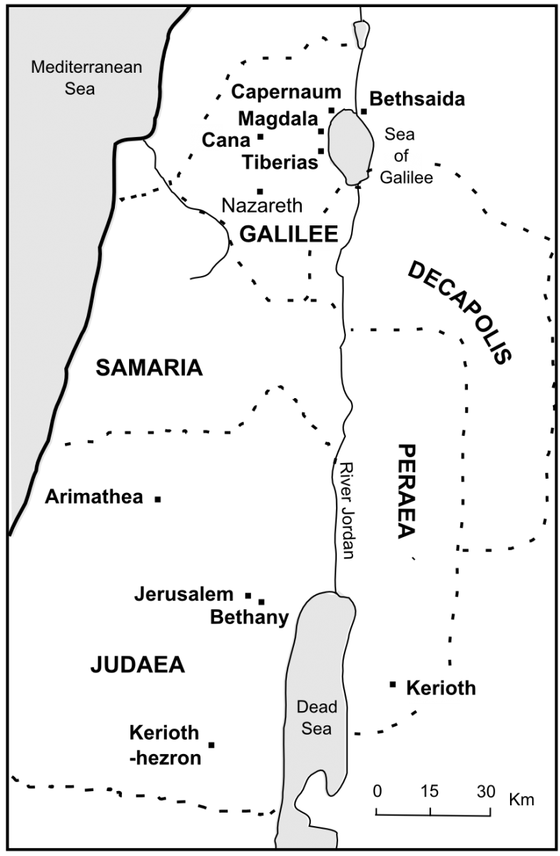

Slide 48
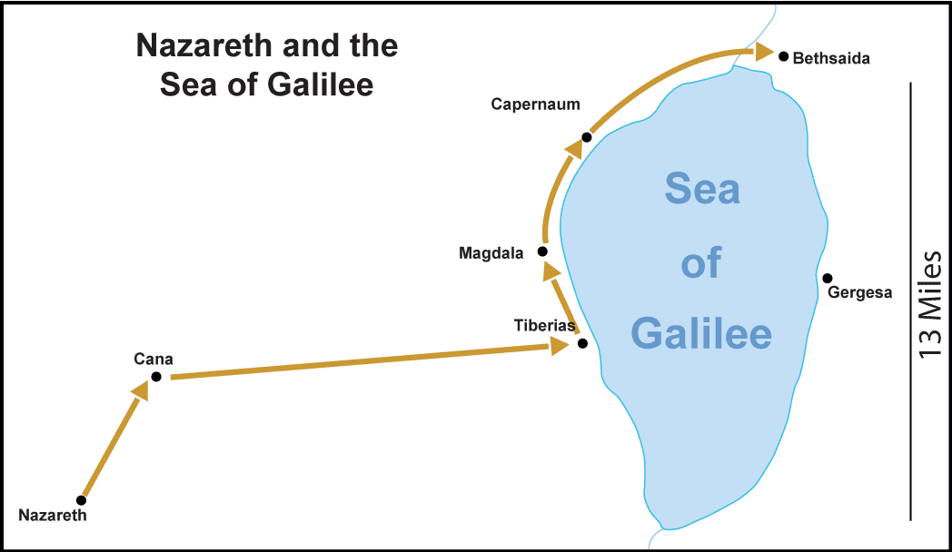
Follow Me: The Gospel According to St. Matthew

Slide 49
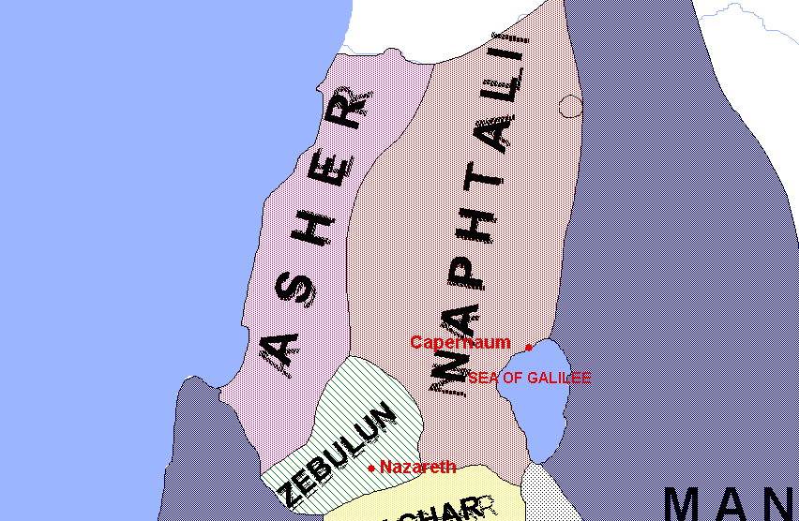
Follow Me: The Gospel According to St. Matthew

Slide 50
Follow Me: The Gospel According to St. Matthew
The Sermon on the Mount
Key Verse
“Do not think that I came to destroy the Law or the Prophets. I did not come to destroy but to fulfill. ”
Matthew 5:17

Slide 51
Follow Me: The Gospel According to St. Matthew
One Outline of the Sermon

Slide 52
Follow Me: The Gospel According to St. Matthew
One Outline of the Sermon
Introduction 5:1-20

Slide 53
Follow Me: The Gospel According to St. Matthew
One Outline of the Sermon
Introduction 5:1-20
The Antitheses 5:21-48

Slide 54
Follow Me: The Gospel According to St. Matthew
One Outline of the Sermon
Introduction 5:1-20
The Antitheses 5:21-48
Acts of Piety 6:1-18

Slide 55
Follow Me: The Gospel According to St. Matthew
One Outline of the Sermon
Introduction 5:1-20
The Antitheses 5:21-48
Acts of Piety 6:1-18
Other Teachings 6:19-7:12

Slide 56
Follow Me: The Gospel According to St. Matthew
One Outline of the Sermon
Introduction 5:1-20
The Antitheses 5:21-48
Acts of Piety 6:1-18
Other Teachings 6:19-7:12
Warnings about Judgment 7:13-29

Slide 57
Follow Me: The Gospel According to St. Matthew
Introduction to the Sermon

Slide 58
Follow Me: The Gospel According to St. Matthew
Introduction to the Sermon
Setting

Slide 59
Follow Me: The Gospel According to St. Matthew
Introduction to the Sermon
Setting
The Beatitudes

Slide 60
Follow Me: The Gospel According to St. Matthew
Introduction to the Sermon
Setting
The Beatitudes
The Salt and the Light

Slide 61
Follow Me: The Gospel According to St. Matthew
Introduction to the Sermon
Setting
The Beatitudes
The Salt and the Light
Christ Fulfills the Law

Slide 62
Follow Me: The Gospel According to St. Matthew
Beatitudes

Slide 63
Follow Me: The Gospel According to St. Matthew
Beatitudes
Bookendings themselves

Slide 64
Follow Me: The Gospel According to St. Matthew
Beatitudes
Bookendings themselves
A common form in Hebrew Literature

Slide 65
Follow Me: The Gospel According to St. Matthew
Beatitudes
Bookendings themselves
A common form in Hebrew Literature
All look to a future reward

Slide 66
Follow Me: The Gospel According to St. Matthew
The Antitheses

Slide 67
Follow Me: The Gospel According to St. Matthew
The Antitheses
Six statements which follow the format: “You have heard it said…, but I say to you…”

Slide 68
Follow Me: The Gospel According to St. Matthew
The Antitheses
Six statements which follow the format: “You have heard it said…, but I say to you…”
Topics are: murder, adultery, divorce, oaths, “an eye for an eye,” and loving your neighbor

Slide 69
Follow Me: The Gospel According to St. Matthew
The Antitheses
Six statements which follow the format: “You have heard it said…, but I say to you…”
Topics are: murder, adultery, divorce, oaths, “an eye for an eye,” and loving your neighbor
These are all examples of how Jesus how has not abolished the law but fulfilled it!

Slide 70
Follow Me: The Gospel According to St. Matthew
Acts of Piety

Slide 71
Follow Me: The Gospel According to St. Matthew
Acts of Piety
A corrective teaching on almsgiving, prayer, and fasting

Slide 72
Follow Me: The Gospel According to St. Matthew
Acts of Piety
A corrective teaching on almsgiving, prayer, and fasting
Similar to the antitheses in structure.

Slide 73
Follow Me: The Gospel According to St. Matthew
Other Teachings

Slide 74
Follow Me: The Gospel According to St. Matthew
Other Teachings
A hodge-podge of pithy sayings without a cohesive, unifying theme or structure,

Slide 75
Follow Me: The Gospel According to St. Matthew
Other Teachings
A hodge-podge of pithy sayings without a cohesive, unifying theme or structure,
Very reminiscent of Jewish Wisdom Literature, especially Proverbs and Ecclesiastes,

Slide 76
Follow Me: The Gospel According to St. Matthew
Other Teachings
A hodge-podge of pithy sayings without a cohesive, unifying theme or structure,
Very reminiscent of Jewish Wisdom Literature, especially Proverbs and Ecclesiastes,
Contains beautiful passages regarding not worrying, and the Golden Rule summarizing the “Law and the Prophets” (7:12)

Slide 77
Follow Me: The Gospel According to St. Matthew
Warnings about Judgment

Slide 78
Follow Me: The Gospel According to St. Matthew
Warnings about Judgment
Four separate (related) warnings

Slide 79
Follow Me: The Gospel According to St. Matthew
Warnings about Judgment
Four separate (related) warnings
Narrow Gate vs. the Broad Way

Slide 80
Follow Me: The Gospel According to St. Matthew
Warnings about Judgment
Four separate (related) warnings
Narrow Gate vs. the Broad Way
Good Trees (fruit) vs. Bad Trees (fruit)

Slide 81
Follow Me: The Gospel According to St. Matthew
Warnings about Judgment
Four separate (related) warnings
Narrow Gate vs. the Broad Way
Good Trees (fruit) vs. Bad Trees (fruit)
“he who does the will of My Father in heaven” vs. “everyone who says to Me, ‘Lord, Lord!’”

Slide 82
Follow Me: The Gospel According to St. Matthew
Warnings about Judgment
Four separate (related) warnings
Narrow Gate vs. the Broad Way
Good Trees (fruit) vs. Bad Trees (fruit)
“he who does the will of My Father in heaven” vs. “everyone who says to Me, ‘Lord, Lord!’”
Solid Foundation vs. Sandy Foundation

Slide 83
Follow Me: The Gospel According to St. Matthew
Warnings about Judgment
Four separate (related) warnings
Narrow Gate vs. the Broad Way
Good Trees (fruit) vs. Bad Trees (fruit)
“he who does the will of My Father in heaven” vs. “everyone who says to Me, ‘Lord, Lord!’”
Solid Foundation vs. Sandy Foundation
Destruction comes for those who make the wrong choice!

Slide 84
Follow Me: The Gospel According to St. Matthew
The Conclusion of the Sermon
“And so it was, when Jesus had ended these sayings, that the people were astonished at His teaching, for He taught them as one having authority, and not as the scribes.”
Matthew 7:28-29

Slide 85
Follow Me: The Gospel According to St. Matthew
The Conclusion of the Sermon

Slide 86
Follow Me: The Gospel According to St. Matthew
The Conclusion of the Sermon
The same formula that Matthew uses to conclude each sermon/book of Jesus.

Slide 87
Follow Me: The Gospel According to St. Matthew
The Conclusion of the Sermon
The same formula that Matthew uses to conclude each sermon/book of Jesus.
Based on Deuteronomy 32:45, “Moses finished speaking all these words to all Israel…”

Slide 88
Follow Me: The Gospel According to St. Matthew
The Conclusion of the Sermon
The same formula that Matthew uses to conclude each sermon/book of Jesus.
Based on Deuteronomy 32:45, “Moses finished speaking all these words to all Israel…”
Helps establish the difference between Jesus and his rivals, “the scribes”: authority!

Slide 89
Follow Me: The Gospel According to St. Matthew
Next week:
The Feast of the Transfiguration
Wednesday August 6th
Special Eucharistic Service

Slide 90
Follow Me: The Gospel According to St. Matthew
The Following Week!
Jesus’ Miracles and
the Missionary Discourse
(Chapters 8-10)

