Slide 1
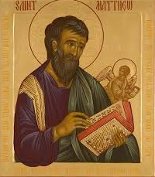
Church of the Messiah
invites you to
Follow Me:
an Introduction to the Gospel
According to Saint Matthew
An 8-Week Study of the Gospel
beginning July 16th at 7pm
3754 University Club Blvd.
mycomjax.com
#FollowMe

Slide 2
Follow Me: The Gospel According to St. Matthew
While each of the evangelists ultimately tells the same story, each presents their version of the Gospel in a way that is uniquely their own.

Slide 3
Follow Me: The Gospel According to St. Matthew
While each of the evangelists ultimately tells the same story, each presents their version of the Gospel in a way that is uniquely their own.
This makes perfect sense because, afterall, these were wildly different men coming from completely varied backgrounds. Their very distinct backgrounds and ultimately their different intended audiences as well make for some distinctive differences in their retellings of the story of Jesus Christ.

Slide 4
Follow Me: The Gospel According to St. Matthew
St. Mark—possibly only connected to Jesus in Mark 14:51-52; a cousin and co-laborer of Barnabas (and Paul) and disciple of Peter.

Slide 5
Follow Me: The Gospel According to St. Matthew
St. Mark—possibly only connected to Jesus in Mark 14:51-52; a cousin and co-laborer of Barnabas (and Paul) and disciple of Peter.
St. Luke—a Syrian physician traveled extensively with Paul on his missionary journeys.

Slide 6
Follow Me: The Gospel According to St. Matthew
St. Mark—possibly only connected to Jesus in Mark 14:51-52; a cousin and co-laborer of Barnabas (and Paul) and disciple of Peter.
St. Luke—a Syrian physician traveled extensively with Paul on his missionary journeys.
St. John—one of The Twelve, “The Beloved Disciple,” a fisherman called one of the “Sons of Thunder,” the only Apostle not martyred.

Slide 7
Follow Me: The Gospel According to St. Matthew
St. Matthew—one of the Apostles, like John, an eyewitness to much of what transpired in the life and ministry of Jesus, but not all. Matthew was a tax collector, in the eyes of most Jews a traitor and collaborator with the Roman occupiers. He was also known as Levi, the son of Alphaeus (in Mark 2:14 and Luke 5:27).

Slide 8
Follow Me: The Gospel According to St. Matthew
Intended Audience

Slide 9
Follow Me: The Gospel According to St. Matthew
Intended Audience
St. Mark’s—most likely Roman Christians or Christians in hiding dealing with persecution.

Slide 10
Follow Me: The Gospel According to St. Matthew
Intended Audience
St. Mark’s—most likely Roman Christians or Christians in hiding dealing with persecution.
St. Luke’s—ostensibly “O Theophilus,” maybe there was a larger reason.

Slide 11
Follow Me: The Gospel According to St. Matthew
Intended Audience
St. Mark’s—most likely Roman Christians or Christians in hiding dealing with persecution.
St. Luke’s—ostensibly “O Theophilus,” maybe there was a larger reason.
St. John’s—most likely Ephesus or Antioch, where most of the Apostle’s later ministry was centered. His message is not so audience-specific.

Slide 12
Follow Me: The Gospel According to St. Matthew
Intended Audience
St. Matthew’s—while we do not know exactly where the audience was geographically located, we do know how they were culturally located: they were JEWISH!
St. Matthew’s version of the Gospel is the most Jewish version of the life of Christ.

Slide 13
Follow Me: The Gospel According to St. Matthew
“Matthew also issued a written Gospel among the Hebrews in their own dialect, while Peter and Paul were preaching in Rome and laying the foundation of the Church. After their departure, Mark, the disciple and interpreter of Peter, did also hand down to us in writing what had been preached by Peter. Luke also, the companion of Paul, recorded in a book the Gospel preached by him. Afterwards John, the disciple of the Lord, who also had leaned upon his breast, did himself publish a Gospel during his residence at Ephesus in Asia.”
Irenaeus of Lyon, ca 180AD

Slide 14
Follow Me: The Gospel According to St. Matthew
The key to understanding St. Matthew’s approach to the life of Christ is found in Deuteronomy 18:15-18,

Slide 15
Follow Me: The Gospel According to St. Matthew
The key to understanding St. Matthew’s approach to the life of Christ is found in Deuteronomy 18:15-18,
Moses says, “The LORD your God will raise up for you a prophet like me from among you, from among your brothers…. And the LORD said to me, ‘I will raise up for them a prophet like you from among their brothers. And I will put My words in his mouth, and he shall speak to them all that I command him.”

Slide 16
Follow Me: The Gospel According to St. Matthew
Similarities Between Jesus and Moses

Slide 17
Follow Me: The Gospel According to St. Matthew
Similarities Between Jesus and Moses
Born while their people were oppressed

Slide 18
Follow Me: The Gospel According to St. Matthew
Similarities Between Jesus and Moses
Born while their people were oppressed
Massacre of innocents followed their birth

Slide 19
Follow Me: The Gospel According to St. Matthew
Similarities Between Jesus and Moses
Born while their people were oppressed
Massacre of innocents followed their birth
Escaped by hiding in Egypt

Slide 20
Follow Me: The Gospel According to St. Matthew
Similarities Between Jesus and Moses
Born while their people were oppressed
Massacre of innocents followed their birth
Escaped by hiding in Egypt
Fasted for forty days

Slide 21
Follow Me: The Gospel According to St. Matthew
Similarities Between Jesus and Moses
Born while their people were oppressed
Massacre of innocents followed their birth
Escaped by hiding in Egypt
Fasted for forty days
Put 12 people “next in charge”

Slide 22
Follow Me: The Gospel According to St. Matthew
Similarities Between Jesus and Moses
Born while their people were oppressed
Massacre of innocents followed their birth
Escaped by hiding in Egypt
Fasted for forty days
Put 12 people “next in charge”
Appointed 70 disciples

Slide 23
Follow Me: The Gospel According to St. Matthew
Similarities Between Jesus and Moses
Gave the people bread in the wilderness

Slide 24
Follow Me: The Gospel According to St. Matthew
Similarities Between Jesus and Moses
Gave the people bread in the wilderness
Preached an impressive sermon on a mountain

Slide 25
Follow Me: The Gospel According to St. Matthew
Similarities Between Jesus and Moses
Gave the people bread in the wilderness
Preached an impressive sermon on a mountain
Had a face which shined with glory

Slide 26
Follow Me: The Gospel According to St. Matthew
Similarities Between Jesus and Moses
Gave the people bread in the wilderness
Preached an impressive sermon on a mountain
Had a face which shined with glory
That whole Passover thing!

Slide 27
Follow Me: The Gospel According to St. Matthew
Similarities Between Jesus and Moses
Gave the people bread in the wilderness
Preached an impressive sermon on a mountain
Had a face which shined with glory
That whole Passover thing!
…the list goes on and on!

Slide 28
Follow Me: The Gospel According to St. Matthew
What difference does this really make today?

Slide 29
Follow Me: The Gospel According to St. Matthew
What difference does this really make today?
Moses gave us The Torah, the Five Books of Moses…

Slide 30
Follow Me: The Gospel According to St. Matthew
What difference does this really make today?
Moses gave us The Torah, the Five Books of Moses…
In St. Matthew’s Gospel, Jesus gives us five very long sermons

Slide 31
Follow Me: The Gospel According to St. Matthew
Jesus’ Five “Books” in St. Matthew are:

Slide 32
Follow Me: The Gospel According to St. Matthew
Jesus’ Five “Books” in St. Matthew are:
The Sermon on the Mount (5-7)

Slide 33
Follow Me: The Gospel According to St. Matthew
Jesus’ Five “Books” in St. Matthew are:
The Sermon on the Mount (5-7)
The Missionary Discourse (10)

Slide 34
Follow Me: The Gospel According to St. Matthew
Jesus’ Five “Books” in St. Matthew are:
The Sermon on the Mount (5-7)
The Missionary Discourse (10)
Parables of the Kingdom (13)

Slide 35
Follow Me: The Gospel According to St. Matthew
Jesus’ Five “Books” in St. Matthew are:
The Sermon on the Mount (5-7)
The Missionary Discourse (10)
Parables of the Kingdom (13)
Advice to the Church (18)

Slide 36
Follow Me: The Gospel According to St. Matthew
Jesus’ Five “Books” in St. Matthew are:
The Sermon on the Mount (5-7)
The Missionary Discourse (10)
Parables of the Kingdom (13)
Advice to the Church (18)
The Olivet Discourse (24-25)

Slide 37
Follow Me: The Gospel According to St. Matthew
Don’t believe me?

Slide 38
Follow Me: The Gospel According to St. Matthew
Don’t believe me?
Each sermon ends with words to the effect of “when Jesus had finished these sayings…”
See 7:28; 11:1; 13:53; 19:1; and 26:1

Slide 39
Follow Me: The Gospel According to St. Matthew
Don’t believe me?
Each sermon ends with words to the effect of “when Jesus had finished these sayings…”
See 7:28; 11:1; 13:53; 19:1; and 26:1
This brings us to our schedule for the Bible study…

Slide 40
Follow Me: The Gospel According to St. Matthew
Week 1—July 16th: Introduction
Week 2—July 23rd: The Infancy Narrative
Week 3—July 30th: The Beginning of Jesus’ Ministry and the Sermon on the Mount
August 6th—Feast of the Transfiguration
Week 4—August 13th: Jesus’s Miracles and the Missionary Discourse

Slide 41
Follow Me: The Gospel According to St. Matthew
Week 5—August 20th: Jesus Rejected & Parables of the Kingdom
Week 6—August 27th: Miracles, Controversies, and the Cross, & Advice to the Church
Week 7—September 3rd: The Olivet Discourse
Week 8—September 10th: Jesus’ Passion and Resurrection

Slide 42
Follow Me: The Gospel According to St. Matthew
Now on to some “Fun Stuff”…
How many of you have ever seen images like these?

Slide 43
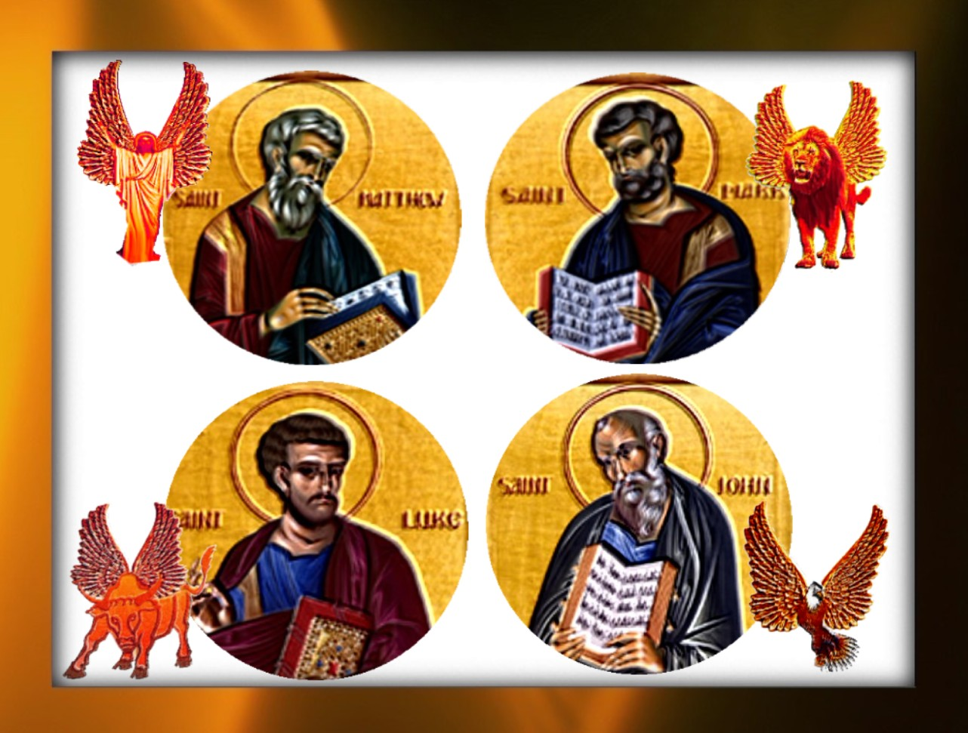
Follow Me: The Gospel According to St. Matthew

Slide 44
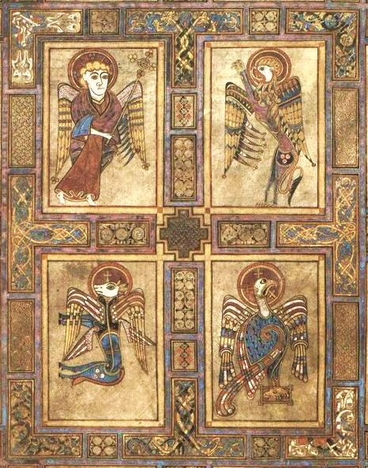
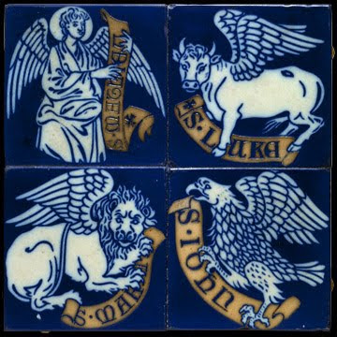
Follow Me: The Gospel According to St. Matthew

Slide 45
Follow Me: The Gospel According to St. Matthew
Also from within it came the likeness of four living creatures. And this was their appearance: they had the likeness of a man. Each one had four faces, and each one had four wings.
As for the likeness of their faces, each had the face of a man; each of the four had the face of a lion on the right side, each of the four had the face of an ox on the left side, and each of the four had the face of an eagle. Thus were their faces.
Ezekiel 1: 5-6, 10-11

Slide 46
Follow Me: The Gospel According to St. Matthew
St. Jerome gave this explanation for why each of the evangelists is represented as they are:
“The first face of a man signifies Matthew, who began his narrative as though about a man: ‘The book of the generation of Jesus Christ the son of David, the son of Abraham.’…

Slide 47
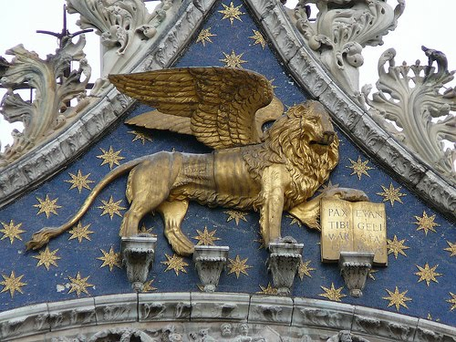
Follow Me: The Gospel According to St. Matthew
“The second face signifies Mark in whom the voice of a lion roaring in the wilderness is heard: “A voice of one shouting in the desert: Prepare the way of the Lord, make his paths straight.”

Slide 48
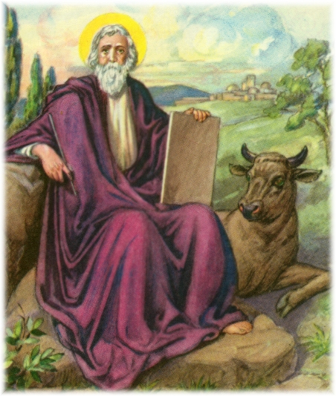
Follow Me: The Gospel According to St. Matthew
“The third is the face of the calf which prefigures that the evangelist Luke began with Zachariah the priest.

Slide 49
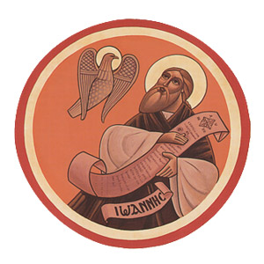
Follow Me: The Gospel According to St. Matthew
“The fourth face signifies John the evangelist who, having taken up eagle’s wings and hastening toward higher matters, discusses the Word of God.”

Slide 50
Follow Me: The Gospel According to St. Matthew
Next Week:
The Infancy Narratives
Chapters 1 & 2

