Slide 1
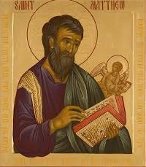
Church of the Messiah
invites you to
Follow Me:
an Introduction to the Gospel
According to Saint Matthew
An 8-Week Study of the Gospel
beginning July 16th at 7pm
3754 University Club Blvd.
mycomjax.com
#FollowMe

Slide 2
Follow Me: The Gospel According to St. Matthew
Week 1—July 16th: Introduction
Week 2—July 23rd: The Infancy Narrative
Week 3—July 30th: The Beginning of Jesus’ Ministry and the Sermon on the Mount
August 6th—Feast of the Transfiguration
Week 4—August 13th: Jesus’s Miracles and the Missionary Discourse

Slide 3
Follow Me: The Gospel According to St. Matthew
Week 5—August 20th: Jesus Rejected & Parables of the Kingdom
Week 6—August 27th: Miracles, Controversies, and the Cross, & Advice to the Church
Week 7—September 3rd: The Olivet Discourse
Week 8—September 10th: Jesus’ Passion and Resurrection

Slide 4
Follow Me: The Gospel According to St. Matthew
Matthew 1:1 begins,
“The book of the genealogy of Jesus Christ, the Son of David, the Son of Abraham:”

Slide 5
Follow Me: The Gospel According to St. Matthew
Matthew 1:1 begins,
“The book of the genealogy of Jesus Christ, the Son of David, the Son of Abraham:”
The word “genealogy” is γενέσεως or ‘genesis.’ The words means both “origin,” “birth,” “lineage,” or even “source.”

Slide 6
Follow Me: The Gospel According to St. Matthew
Once we get into the genealogies, Matthew begins with Abraham and follows the pattern: “A begat B, B begat C, C begat D, etc…” Matthew begins with Abraham and ultimately ends with “Joseph, the husband of Mary, of whom was born Jesus who is called Christ.” (v. 16)

Slide 7
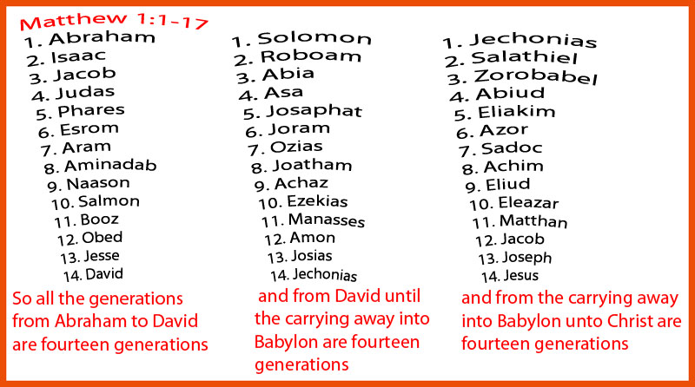
Follow Me: The Gospel According to St. Matthew

Slide 8
Follow Me: The Gospel According to St. Matthew
In Hebrew each letter is assigned a numeric value:

Slide 9
Follow Me: The Gospel According to St. Matthew
In Hebrew each letter is assigned a numeric value:
א

Slide 10
Follow Me: The Gospel According to St. Matthew
In Hebrew each letter is assigned a numeric value:
1
א

Slide 11
Follow Me: The Gospel According to St. Matthew
In Hebrew each letter is assigned a numeric value:
1
א
ב

Slide 12
Follow Me: The Gospel According to St. Matthew
In Hebrew each letter is assigned a numeric value:
1
2
א
ב

Slide 13
Follow Me: The Gospel According to St. Matthew
In Hebrew each letter is assigned a numeric value:
1
2
א
ב
ג

Slide 14
Follow Me: The Gospel According to St. Matthew
In Hebrew each letter is assigned a numeric value:
1
2
3
א
ב
ג

Slide 15
Follow Me: The Gospel According to St. Matthew
In Hebrew each letter is assigned a numeric value:
1
2
3
א
ד
ב
ג

Slide 16
Follow Me: The Gospel According to St. Matthew
In Hebrew each letter is assigned a numeric value:
1 4
2
3
א
ד
ב
ג

Slide 17
Follow Me: The Gospel According to St. Matthew
In Hebrew each letter is assigned a numeric value:
1 4
2
3
א
ד
ב
ה
ג

Slide 18
Follow Me: The Gospel According to St. Matthew
In Hebrew each letter is assigned a numeric value:
1 4
2 5
3
א
ד
ב
ה
ג

Slide 19
Follow Me: The Gospel According to St. Matthew
In Hebrew each letter is assigned a numeric value:
1 4
2 5
3
א
ד
ב
ה
ג
ו

Slide 20
Follow Me: The Gospel According to St. Matthew
In Hebrew each letter is assigned a numeric value:
1 4
2 5
3 6
א
ד
ב
ה
ג
ו

Slide 21
Follow Me: The Gospel According to St. Matthew
In Hebrew each letter is assigned a numeric value:
ד
ו
ד

Slide 22
Follow Me: The Gospel According to St. Matthew
In Hebrew each letter is assigned a numeric value:
D V D
ד
ו
ד

Slide 23
Follow Me: The Gospel According to St. Matthew
In Hebrew each letter is assigned a numeric value:
D a V i D
ד
ו
ד

Slide 24
Follow Me: The Gospel According to St. Matthew
In Hebrew each letter is assigned a numeric value:
D a V i D
4 6 4 =
ד
ו
ד

Slide 25
Follow Me: The Gospel According to St. Matthew
In Hebrew each letter is assigned a numeric value:
D a V i D
4 6 4 = 14
ד
ו
ד

Slide 26
Follow Me: The Gospel According to St. Matthew
Remember that in Hebrew there is no comparative or superlative case for adjectives. Angels do not tell the Lord that He is the holiest; they cry out, “Holy, Holy, Holy.”

Slide 27
Follow Me: The Gospel According to St. Matthew
Remember that in Hebrew there is no comparative or superlative case for adjectives. Angels do not tell the Lord that He is the holiest; they cry out, “Holy, Holy, Holy.”
The arrangement of the genealogy shows that Jesus is ‘Davidic, Davidic, Davidic.’ He is the ‘Most David-like Possible.’ Of course, He should be since He would be the Son of David, reclaim the throne of David, and establish the Kingdom of God forever and ever!

Slide 28
Follow Me: The Gospel According to St. Matthew
There is another wrinkle in the genealogy of Jesus however, and that is that Saints Matthew’s and Luke’s genealogies do not line up.

Slide 29
Follow Me: The Gospel According to St. Matthew
Differences Between Matthean & Lucan Genealogies:
1: Matthew—Abraham begat Isaac, Isaac begat Jacob, etc…
Luke—…the son of Jacob, the son of Isaac, the son of Abraham, etc…

Slide 30
Follow Me: The Gospel According to St. Matthew
Differences Between Matthean & Lucan Genealogies:
2: Matthew begins with Abraham and works his way down to Jesus; Luke begins with Jesus and works his was back to Adam.

Slide 31
Follow Me: The Gospel According to St. Matthew
Differences Between Matthean & Lucan Genealogies:
2: Matthew begins with Abraham and works his way down to Jesus; Luke begins with Jesus and works his was back to Adam.
3: Starting after David, Matthew traces Jesus’ lineage through Solomon; Luke traces it through Nathan!

Slide 32
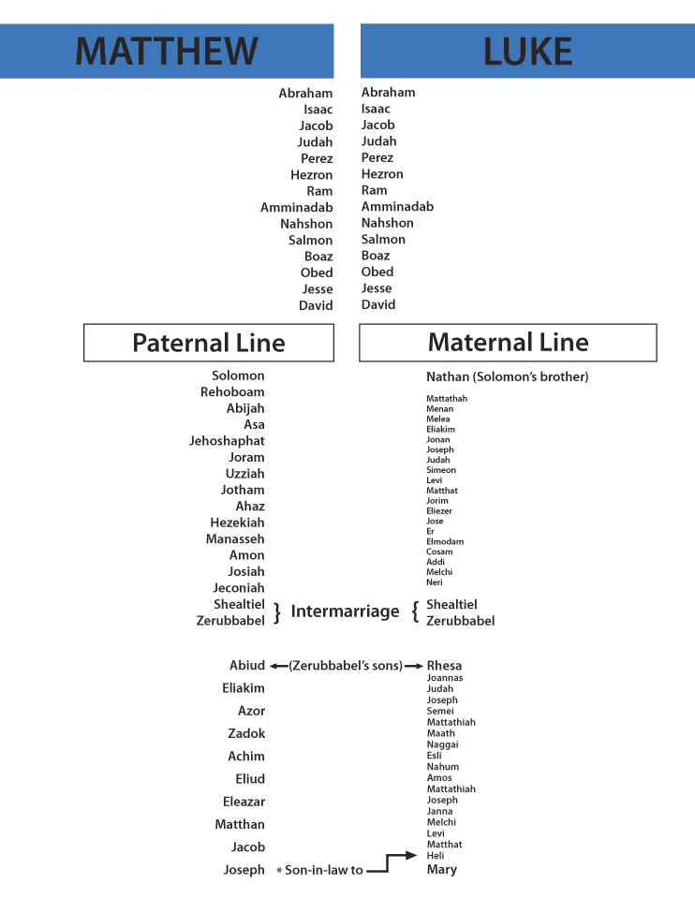

Slide 33
Follow Me: The Gospel According to St. Matthew
Differences Between Matthean & Lucan Genealogies:
4: Matthew includes five women in the genealogy of Jesus; Luke (ironically) includes none!

Slide 34
Follow Me: The Gospel According to St. Matthew
These women are:
Tamar
Rahab
Ruth
Bath-Sheba
and The Virgin Mary

Slide 35
Follow Me: The Gospel According to St. Matthew
“Now the birth of Jesus took place in this way.” (1:18)

Slide 36
Follow Me: The Gospel According to St. Matthew
“Now the birth of Jesus took place in this way.” (1:18)
In the rest of the first chapter of Matthew’s account of the birth of Christ, Mary is almost a secondary figure. It is Joseph who takes the role of the protagonist. Elizabeth and Zechariah are not even mentioned.

Slide 37
Follow Me: The Gospel According to St. Matthew
But while he thought about these things, behold, an angel of the Lord appeared to him in a dream, saying, “Joseph, son of David, do not be afraid to take to you Mary your wife, for that which is conceived in her is of the Holy Spirit. And she will bring forth a Son, and you shall call His name Jesus, for He will save His people from their sins.” (1:20-21)

Slide 38
Follow Me: The Gospel According to St. Matthew
So all this was done that it might be fulfilled which was spoken by the Lord through the prophet, saying: “Behold, the virgin shall be with child, and bear a Son, and they shall call His name Immanuel,” which is translated, “God with us.” (1:22-23)

Slide 39
Follow Me: The Gospel According to St. Matthew
Who was “Herod the king”?

Slide 40
Follow Me: The Gospel According to St. Matthew
Who was “Herod the king”?
Born ~73BC and died ~4BC

Slide 41
Follow Me: The Gospel According to St. Matthew
Who was “Herod the king”?
Born ~73BC and died ~4BC
Not the Herod that murdered John the Baptist and dead with Jesus

Slide 42
Follow Me: The Gospel According to St. Matthew
Who was “Herod the king”?
Born ~73BC and died ~4BC
Not the Herod that murdered John the Baptist and dead with Jesus
Not the Herod that murdered St. James

Slide 43
Follow Me: The Gospel According to St. Matthew
Who was “Herod the king”?
Born ~73BC and died ~4BC
Not the Herod that murdered John the Baptist and dead with Jesus
Not the Herod that murdered St. James
He did however murder his wife and 2 sons!

Slide 44
Follow Me: The Gospel According to St. Matthew
Who was “Herod the king”?
Born ~73BC and died ~4BC
Not the Herod that murdered John the Baptist and dead with Jesus
Not the Herod that murdered St. James
He did however murder his wife and 2 sons!
He also rebuilt the Temple and controlled Jerusalem for 36 years!

Slide 45
Follow Me: The Gospel According to St. Matthew
Who were “the Magi”?
“Wise Men” is too vague
“Kings” is flat out inaccurate
“astrologers” conveys the wrong idea today

Slide 46
Follow Me: The Gospel According to St. Matthew
What is …
The Septuagint?

Slide 47
Follow Me: The Gospel According to St. Matthew
What is …
The Septuagint?
An ancient Greek translation of the Hebrew Scriptures written between 200-400 BC.

Slide 48
Follow Me: The Gospel According to St. Matthew
So… in the Septuagint, the same word magoi is applied to the Daniel and all of the “wise men” of Babylon in Daniel chapter 2.

Slide 49
Follow Me: The Gospel According to St. Matthew
So… in the Septuagint, the same word magoi is applied to the Daniel and all of the “wise men” of Babylon in Daniel chapter 2.
It may well be that the Magi were the successors of Daniel in Babylon, knowing the Scriptures and looking at night sky, saw the signs and headed to Jerusalem at the appointed time.

Slide 50
Follow Me: The Gospel According to St. Matthew
So they said to him, “In Bethlehem of Judea, for thus it is written by the prophet:
‘But you, Bethlehem, in the land of Judah, Are not the least among the rulers of Judah; For out of you shall come a Ruler Who will shepherd My people Israel.’”
Matthew 2:5-6
Quoting Micah 5:2

Slide 51
Follow Me: The Gospel According to St. Matthew
The Flight into Egypt
“An Angel of the Lord” again “appears to Joseph in a dream”
…that it might be fulfilled which was spoken by the Lord through the prophet, saying, “Out of Egypt I called My Son.”
(Hosea 11:1)

Slide 52
Follow Me: The Gospel According to St. Matthew
The Massacre of the Holy Innocents
There is no historical record of the events depicted in Matthew 1:16-18. Why not?

Slide 53
Follow Me: The Gospel According to St. Matthew
The Massacre of the Holy Innocents
There is no historical record of the events depicted in Matthew 1:16-18. Why not?
Considering the size of Bethlehem and the children who were targeted for execution, some estimates place the number of children murdered in Bethlehem that day at no more than 20 children.

Slide 54
Follow Me: The Gospel According to St. Matthew
Then was fulfilled what was spoken by Jeremiah the prophet, saying:
“A voice was heard in Ramah, Lamentation, weeping, and great mourning, Rachel weeping for her children, Refusing to be comforted, Because they are no more.”
Matthew 1:17-18
Quoting Jeremiah 31:15

Slide 55
Follow Me: The Gospel According to St. Matthew
The Return to Nazareth
Again, “an Angel of the Lord appeared to Joseph in a dream”
Upon Herod the Great’s death, his kingdom was divided up between his three sons:
Archelaus received Judea, Samaria, &Idumea
Herod Antipas received Galilee and Perea
Phillip II received Itrurea and Trachonitis

Slide 56
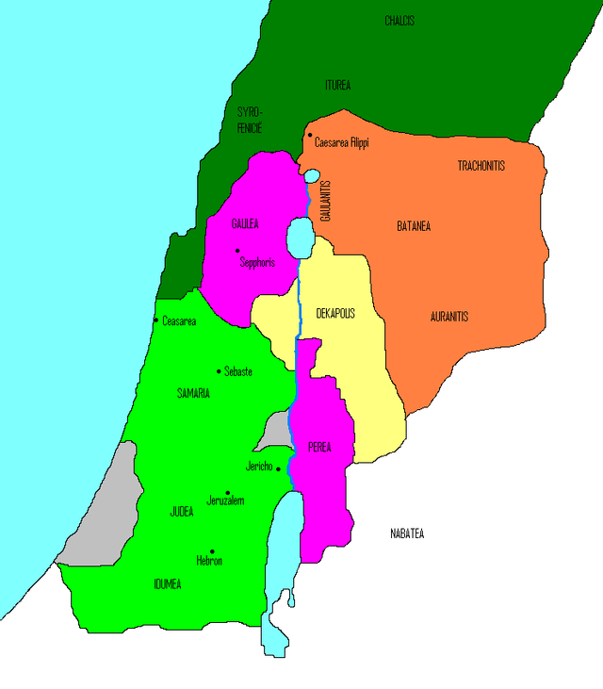

Slide 57
Follow Me: The Gospel According to St. Matthew
The Return to Nazareth
And he came and dwelt in a city called Nazareth, that it might be fulfilled which was spoken by the prophets, “He shall be called a Nazarene.”
Matthew 1:23

Slide 58
Follow Me: The Gospel According to St. Matthew
“Nazarene” can mean:

Slide 59
Follow Me: The Gospel According to St. Matthew
“Nazarene” can mean:
From the city of Nazareth

Slide 60
Follow Me: The Gospel According to St. Matthew
“Nazarene” can mean:
From the city of Nazareth
One especially dedicated to God (Judges 13:5, 7)

Slide 61
Follow Me: The Gospel According to St. Matthew
“Nazarene” can mean:
From the city of Nazareth
One especially dedicated to God (Judges 13:5, 7)
Having to do with “The Branch” (Isaiah 11:1; Zechariah 3:8; 6:12)

Slide 62
Follow Me: The Gospel According to St. Matthew
Next week…
The Beginning of Jesus’ Ministry and
the Sermon on the Mount

