Slide 1
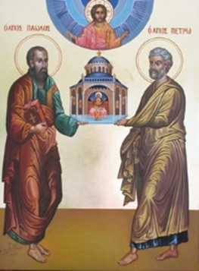
The History of the Biblical Church
A Five-Week Teaching Series
Beginning Wednesday Night, September 14th
Eucharistic Service from 7:00 – 8:30
Free Soup Supper from 6:00 – 6:45
Childcare Provided throughout Service
For More Information Visit:
www.MyCOMJax.com
#BiblicalChurch

Slide 2
Corinth

Slide 4
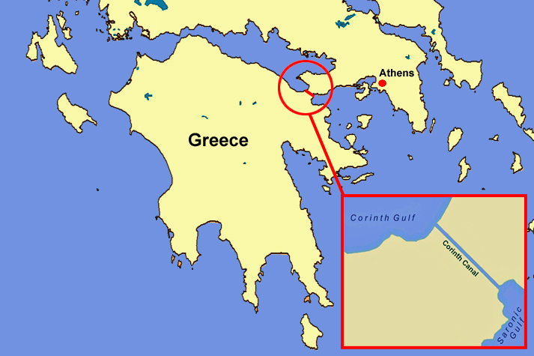

Slide 5
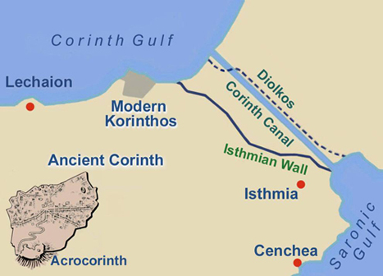

Slide 6
St. Paul’s relationship with Corinth is known as “The Corinthian Correspondence” because he did not just send two letters to them, he had multiple interactions with the Corinthians and sent them at least four letters.
Only two of the letters have become part of our Bible.

Slide 7
Acts of the Apostles gives us the outline for Paul’s first contact with the Corinthians in chapter 18.

Slide 8
Acts of the Apostles gives us the outline for Paul’s first contact with the Corinthians in chapter 18.
“When Gallio was proconsul of Achaia” (18:12) is the single most precisely datable period of time in Acts of the Apostles.

Slide 9
Acts of the Apostles gives us the outline for Paul’s first contact with the Corinthians in chapter 18.
“When Gallio was proconsul of Achaia” (18:12) is the single most precisely datable period of time in Acts of the Apostles.
Gallio was in Corinth from 51-52 AD. Roughly speaking, that is when chapter 18 took place.

Slide 10
After Paul left Corinth he went to Ephesus with Aquila and Priscilla and then moved on to the Holy Land.

Slide 11
After Paul left Corinth he went to Ephesus with Aquila and Priscilla and then moved on to the Holy Land.
While Paul was away Apollos, an Egyptian, arrived in Ephesus, was warmly received by Aquila and Priscilla and then went to Corinth.

Slide 12
On the Third Missionary Journey St. Paul spends three years in Ephesus before making a trip through Macedonia and Achaia (Corinth) and finally returning back to the Holy Land.
St. Luke gives few details about Paul’s trip outside of Ephesus.
St. Paul, however, gives us a great deal of details…

Slide 13
I Corinthians was not Paul’s first correspondence with the people of Corinth!

Slide 14
I Corinthians was not Paul’s first correspondence with the people of Corinth!
A previous letter (I Corinthians 5:9)

Slide 15
I Corinthians was not Paul’s first correspondence with the people of Corinth!
A previous letter (I Corinthians 5:9)
Paul got word from “Chloe’s people” (1:11)

Slide 16
I Corinthians was not Paul’s first correspondence with the people of Corinth!
A previous letter (I Corinthians 5:9)
Paul got word from “Chloe’s people” (1:11)
“Stephanas, Fortunatus, and Achaicus” brought more information from Corinth (16:17)

Slide 17
I Corinthians was not Paul’s first correspondence with the people of Corinth!
A previous letter (I Corinthians 5:9)
Paul got word from “Chloe’s people” (1:11)
“Stephanas, Fortunatus, and Achaicus” brought more information from Corinth (16:17)
Paul had received at least one letter from Corinth

Slide 18
After all of those factors come together, the Apostle wrote what we call the “First Letter of St. Paul to the Corinthians”

Slide 19
After all of those factors come together, the Apostle wrote what we call the “First Letter of St. Paul to the Corinthians”
There is no mystery regarding from whence the epistle was written. St. Paul says, “I will tarry in Ephesus until Pentecost.” (16:8) It was probably written in 56 AD during his 3 year stay in the city.

Slide 20
Interestingly, St. Paul lists Sosthenes as a co-author of I Corinthians in the opening verse.
St. Luke tells us that Sosthenese was “the rules of the synagogue” whom the Jews beat after Gallio released Paul. (18:17)
It appears Sosthenes needed to “get out of town” and left with St. Paul, Aquila, and Priscilla.

Slide 21
Once Paul sent out I Corinthians, he received word that things had gone very poorly in Corinth.

Slide 22
Once Paul sent out I Corinthians, he received word that things had gone very poorly in Corinth.
This prompted an immediate and unsuccessful return trip to Corinth by Paul.

Slide 23
Once Paul sent out I Corinthians, he received word that things had gone very poorly in Corinth.
This prompted an immediate and unsuccessful return trip to Corinth by Paul.
We know this because Paul says, “For I made up my mind not to make another painful visit to you.” (II Corinthians 2:1)

Slide 24
In this “painful visit” we can deduce that, although St. Paul threatened to “come to you with a rod” (I Cor 4:21), we he actually arrived he was far more meek and lowly (II Cor 10:1, 10b).

Slide 25
In this “painful visit” we can deduce that, although St. Paul threatened to “come to you with a rod” (I Cor 4:21), we he actually arrived he was far more meek and lowly (II Cor 10:1, 10b).
His critics mocked the Apostle for being so bold in his letters but humble in person. This is the source of the “pain” in the “painful visit.”

Slide 26
Having returned from the “painful visit,” St. Paul wrote a letter to Corinth. Of that letter, he wrote: “And I wrote as I did, so that when I came I might not suffer pain from those who should have made me rejoice, for I felt sure of all of you, that my joy would be the joy of you all. For I wrote to you out of much affliction and anguish of heart and with many tears, not to cause you pain but to let you know the abundant love that I have for you.”
II Corinthians 2:3-4

Slide 27
This letter—which we do not have—is referred to as “The Letter with Many Tears” and was most likely carried by Titus and well-received.

Slide 28
This letter—which we do not have—is referred to as “The Letter with Many Tears” and was most likely carried by Titus and well-received.
Paul wrote, “But God, who comforts the downcast, comforted us by the coming of Titus, and not only by his coming but also by the comfort with which he was comforted by you, as he told us of your longing, your mourning, your zeal for me, so that I rejoiced still more.”
II Corinthians 7:6-7

Slide 29
Titus brought the good news of the Corinthians’ repentance to St. Paul as the Apostle was moving about and most likely in Philippi. (Acts 20:1)
Immediately upon receiving the good news, St. Paul wrote another letter to the Corinthians. This is what we now call “The Second Epistle of St. Paul to the Corinthians” or II Corinthians.

Slide 30
Having sent II Corinthians, St. Paul followed up the letter with a third and final visit.
In his last letter he speaks of this visit and insists that he will finally deal with those who were causing trouble. (II Cor 12:14; 13:1-2)

Slide 31
The Corinthian Correspondence

Slide 32
The Corinthian Correspondence
St. Paul arrives in Corinth the 1st time

Slide 33
The Corinthian Correspondence
St. Paul arrives in Corinth the 1st time
While in Ephesus St. Paul receives word from various Corinthian groups and writes one “previous” letter.

Slide 34
The Corinthian Correspondence
St. Paul arrives in Corinth the 1st time
While in Ephesus St. Paul receives word from various Corinthian groups and writes one “previous” letter.
St. Paul writes I Corinthians from Ephesus

Slide 35
The Corinthian Correspondence
Apollos and others arrive in Corinth and the situation becomes worse!

Slide 36
The Corinthian Correspondence
Apollos and others arrive in Corinth and the situation becomes worse!
St. Paul makes his “Painful Visit” (his 2nd visit to Corinth)

Slide 37
The Corinthian Correspondence
Apollos and others arrive in Corinth and the situation becomes worse!
St. Paul makes his “Painful Visit” (his 2nd visit to Corinth)
Titus carried St. Paul’s “Letter with Many Tears” to Corinth.

Slide 38
The Corinthian Correspondence
St. Paul receives word of the Corithians’ repentance from Titus in Macedonia and writes II Corinthians

Slide 39
The Corinthian Correspondence
St. Paul receives word of the Corithians’ repentance from Titus in Macedonia and writes II Corinthians
St. Paul visits Corinth one final time before returning to the Holy Land to stand trial and be sent to Rome (his 3rd visit).

