Slide 1
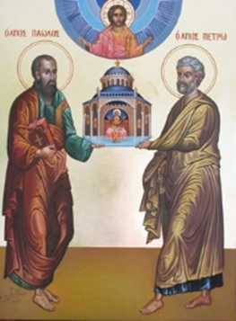
The History of the Biblical Church
A Five-Week Teaching Series
Beginning Wednesday Night, September 14th
Eucharistic Service from 7:00 – 8:30
Free Soup Supper from 6:00 – 6:45
Childcare Provided throughout Service
For More Information Visit:
www.MyCOMJax.com
#BiblicalChurch

Slide 2
Galatians

Slide 3
The Epistle to the Galatians is the only one of St. Paul’s epistles not written to either a specific Christian or Christians in a specific city.

Slide 4
The Epistle to the Galatians is the only one of St. Paul’s epistles not written to either a specific Christian or Christians in a specific city.
Galatia was a Roman Province formed by Augustus Caesar in 25 BC that ran through the center of modern day Turkey.

Slide 5
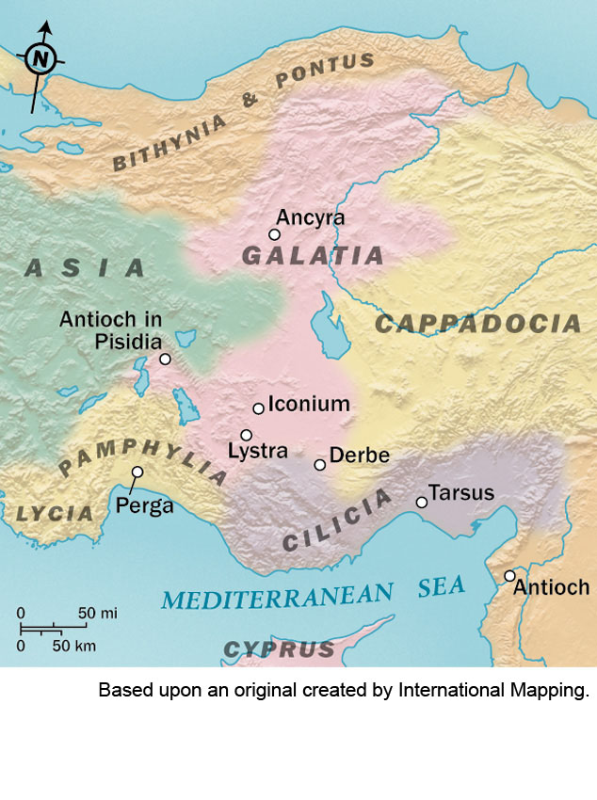

Slide 6
Referring to the letter as “The Epistle to the Galatians” poses a unique problem, because it would be comparable to titling a letter “The Epistle to the New Englanders.”

Slide 7
Referring to the letter as “The Epistle to the Galatians” poses a unique problem, because it would be comparable to titling a letter “The Epistle to the New Englanders.”
We are not really sure to whom St. Paul wrote this letter specifically.

Slide 8
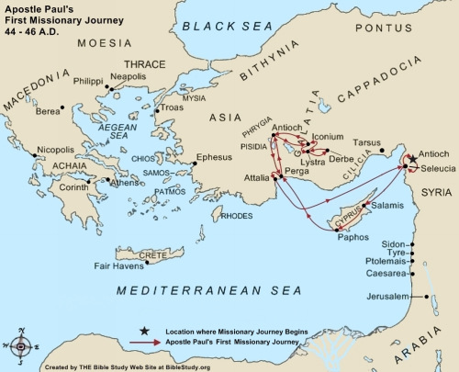
St. Paul’s First Journey

Slide 9
Chapters 13-14 of Acts of the Apostles cover the First Missionary Journey which includes a visit to Galatia.
Chapter 15 covers the Council of Jerusalem where the Apostles decide that one need not be a Jew to be a Christian.
St. Paul also presents a version of the Council of Jerusalem in his own words in Galatians 2.

Slide 10
Following the Council of Jerusalem, Paul, Barnabas, and Silas head back to Antioch and stay there and everything is good.
Acts of the Apostles tells us the Paul and Barnabas become divided over the issue of whether or not to take “John called Mark” with them on the Second Missionary Journey.

Slide 11
St. Paul tells the story a bit differently in his own words.

Slide 12
“Now when Peter had come to Antioch, I withstood him to his face, because he was to be blamed; for before certain men came from James, he would eat with the Gentiles; but when they came, he withdrew and separated himself, fearing those who were of the circumcision. And the rest of the Jews also played the hypocrite with him, so that even Barnabas was carried away with their hypocrisy.”
Galatians 2:11-13

Slide 13
Not Scripture Warning
The Antiochene Orthodox Church considers its first patriarch to be St. Peter and not St. Paul.
All of the earliest sources in Church History say that St. Peter became the first bishop in Antioch, then appointed Ignatius of Antioch to be his successor be leaving for Rome.
Notes:
Eusebius of Ceasarea, St. John Chrysostom, and Theodoret all say this.

Slide 14
“Consider that the longsuffering of our Lord is salvation—as also our beloved brother Paul, according to the wisdom given to him, has written to you, as also in all his epistles, speaking in them of these things, in which are some things hard to understand, which untaught and unstable people twist to their own destruction, as they do also the rest of the Scriptures.”
2 Peter 3:15-16

Slide 15
When did St. Paul write The Epistle to the Galatians?

Slide 16
When did St. Paul write The Epistle to the Galatians?
It was after the Council of Jerusalem

Slide 17
When did St. Paul write The Epistle to the Galatians?
It was after the Council of Jerusalem
Did he get the bad news on his visit during the 2nd Missionary Journey?

Slide 18
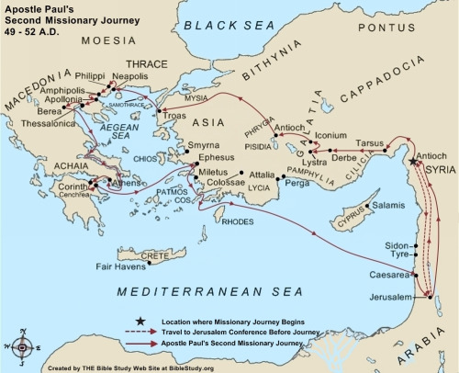
St. Paul’s Second Journey

Slide 19
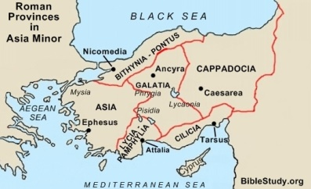

Slide 20
“Now when they had gone through Phrygia and the region of Galatia, they were forbidden by the Holy Spirit to preach the word in Asia. After they had come to Mysia, they tried to go into Bithynia, but the Spirit did not permit them. So passing by Mysia, they came down to Troas. And a vision appeared to Paul in the night. A man of Macedonia stood and pleaded with him, saying, “Come over to Macedonia and help us.” Now after he had seen the vision, immediately we sought to go to Macedonia, concluding that the Lord had called us to preach the gospel to them.”
Acts of the Apostles 16:6-10

Slide 22
When did St. Paul write The Epistle to the Galatians?
It was after the Council of Jerusalem
Did he get the bad news on his visit during the 2nd Missionary Journey?
Did he get the bad news when he passed through on the 3rd Missionary Journey?

Slide 23
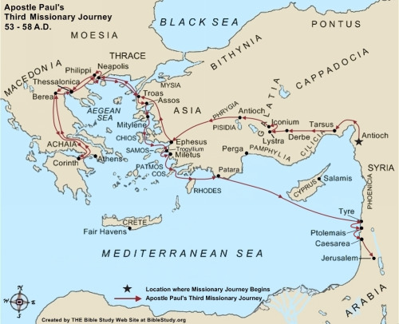
St. Paul’s Third Journey

Slide 24
“After he had spent some time there [in Antioch], he departed and went over the region of Galatia and Phrygia in order, strengthening all the disciples.”
Acts of the Apostles 18:23

Slide 25
When did St. Paul write The Epistle to the Galatians?
It was after the Council of Jerusalem
Did he get the bad news on his visit during the 2nd Missionary Journey?
Did he get the bad news when he passed through on the 3rd Missionary Journey?
Was it during his time in Ephesus?

Slide 26
St. Luke tells us that St. Paul stayed in Ephesus “for two years, so that all who dwelt in Asia heard the word of the Lord Jesus, both Jews and Greeks” (19:10) but then he remained in Ephesus for what may have been another entire year.

Slide 27
St. Paul never again passes through Galatia, nor is he ever really anywhere near the region.

Slide 28
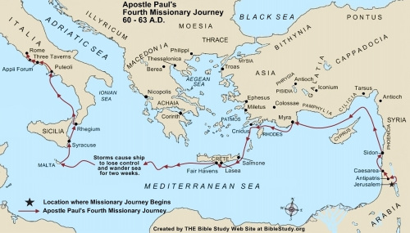
St. Paul’s Fourth Journey

Slide 29
Conclusion:
During the three years that St. Paul was in Ephesus on the 3rd Missionary Journey, messengers came from a city in Galatia and told him what had happened to the churches in the region. He responded by writing his most fiery letter.

